Slide 1
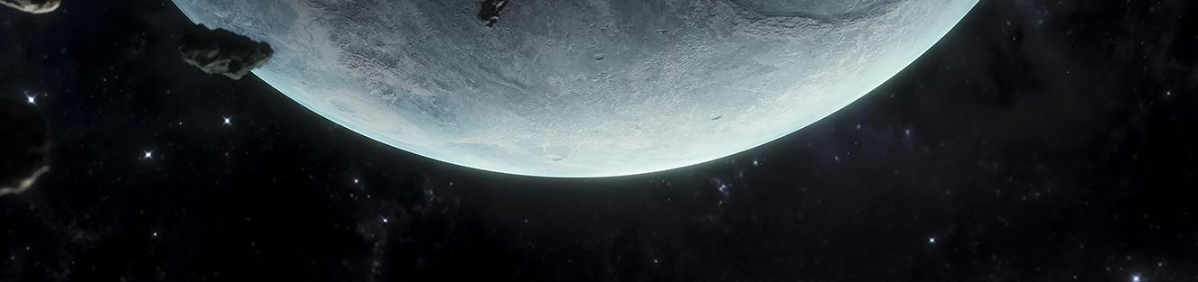
AstroCode Explorers
Dive deep into the space

Slide 2
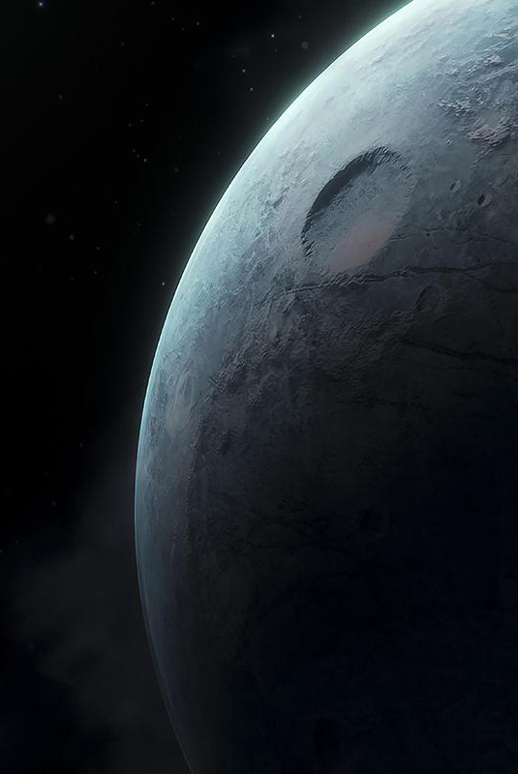
Eclipse Enigma
This interactive game offers you the power to:
Create and customize planets.
Edit their properties and environments.
Manipulate celestial bodies.
Learn about eclipses and their fascinating occurrences.
Try it yourself and make your own eclipse!

Slide 3
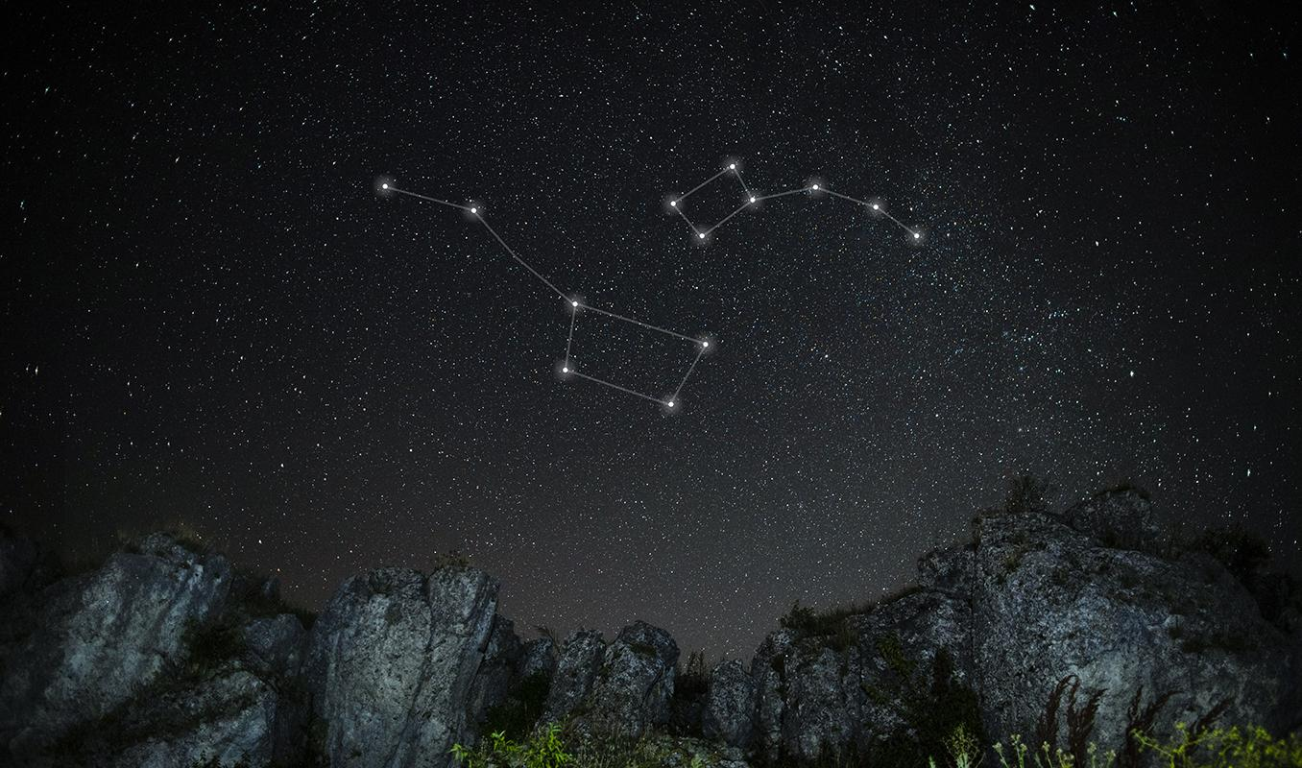
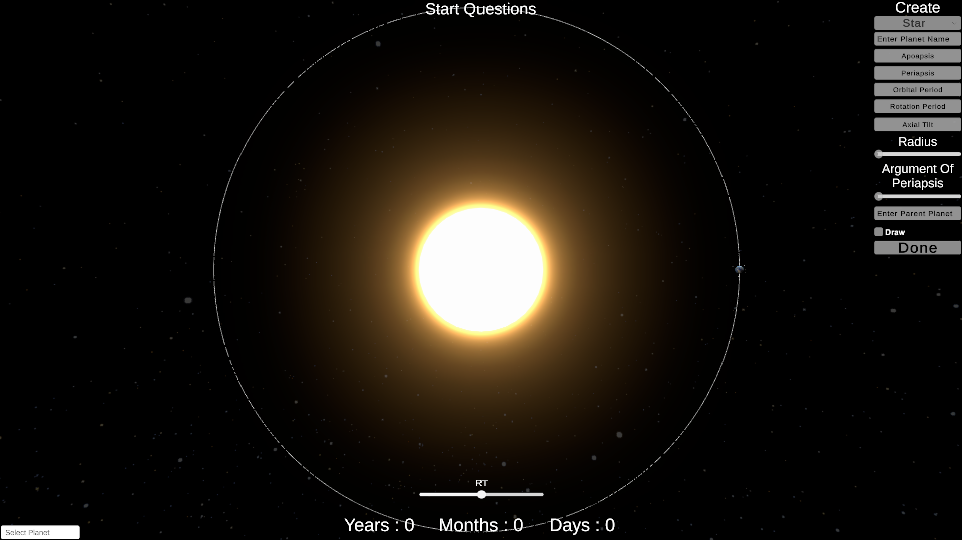
Your Space
Dive into a scientific journey featuring Earth and the Moon.
Experience realism with NASA-derived data.
Customize and observe the impact of changes on these celestial bodies.

Slide 4
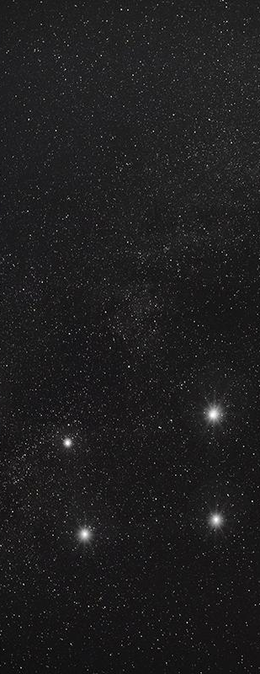
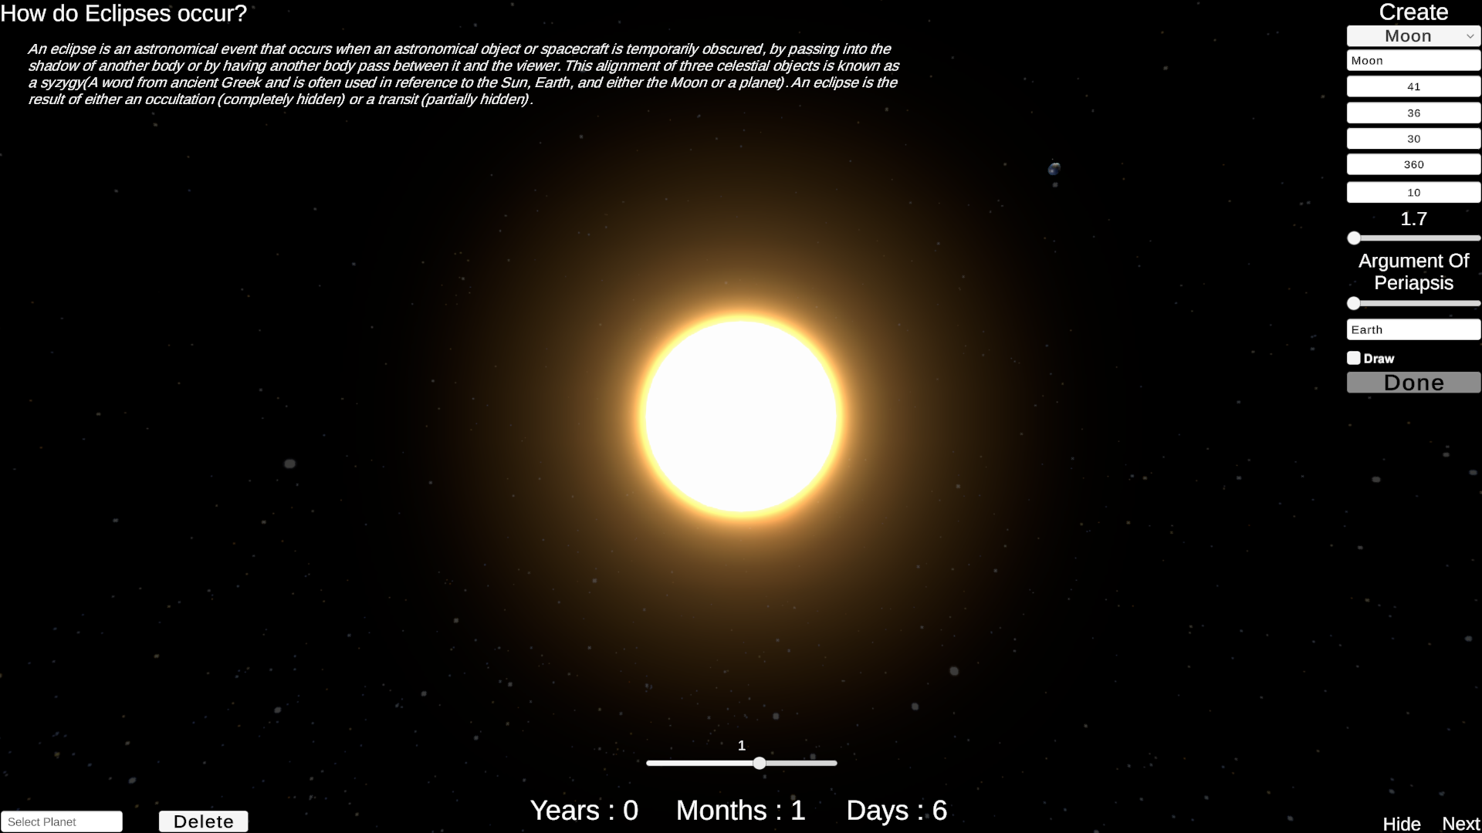
Do you know that?
Information
Embark on an exciting journey into the world of eclipses.
Start the game to unlock information about:
How do eclipses occur?
Why are they significant?
When can you witness them?
Dive into the narrative and explore at your own pace.

Slide 5
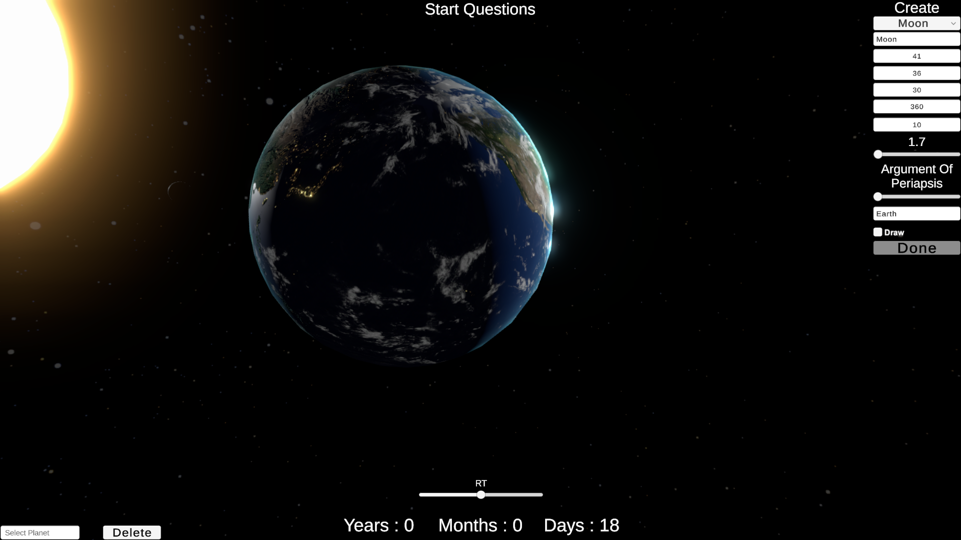
Solar Eclipse
Understand the mechanics: How does it happen?
Explore eclipse types.
Witness the celestial spectacle from space.

Slide 6
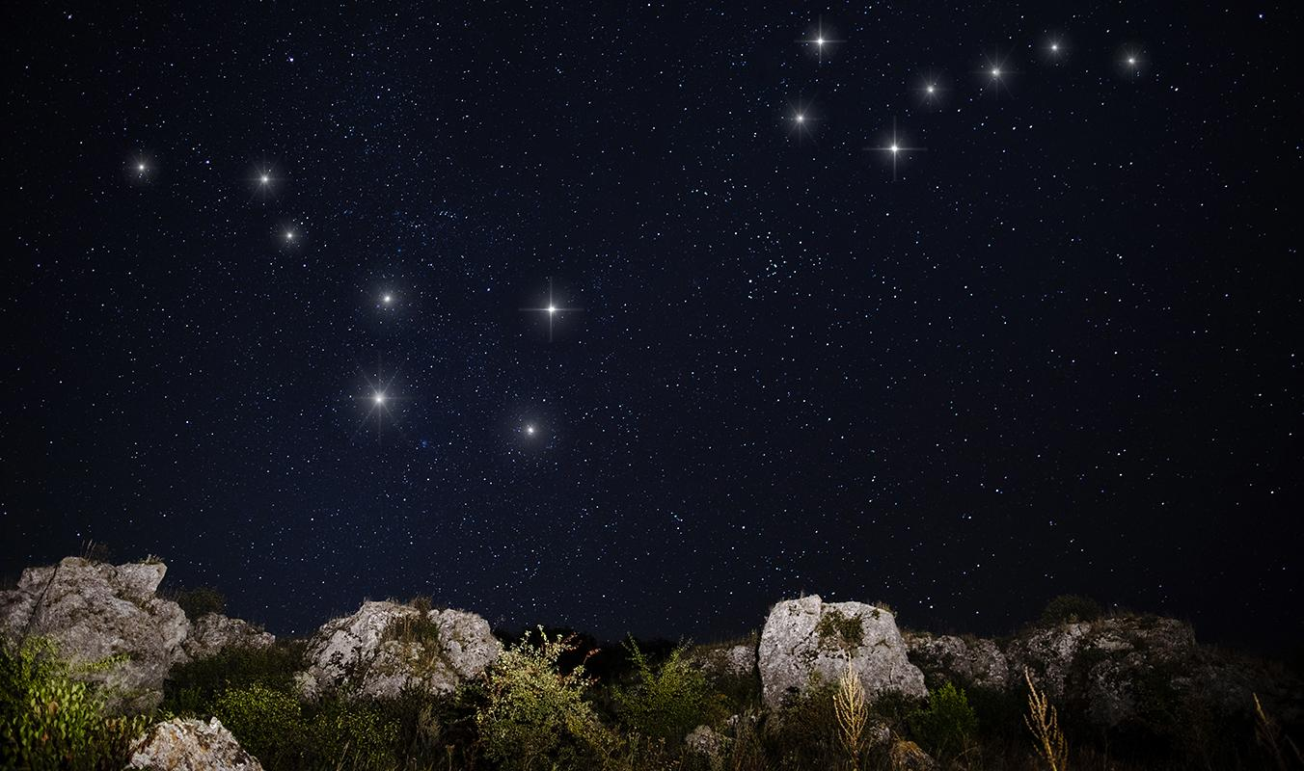
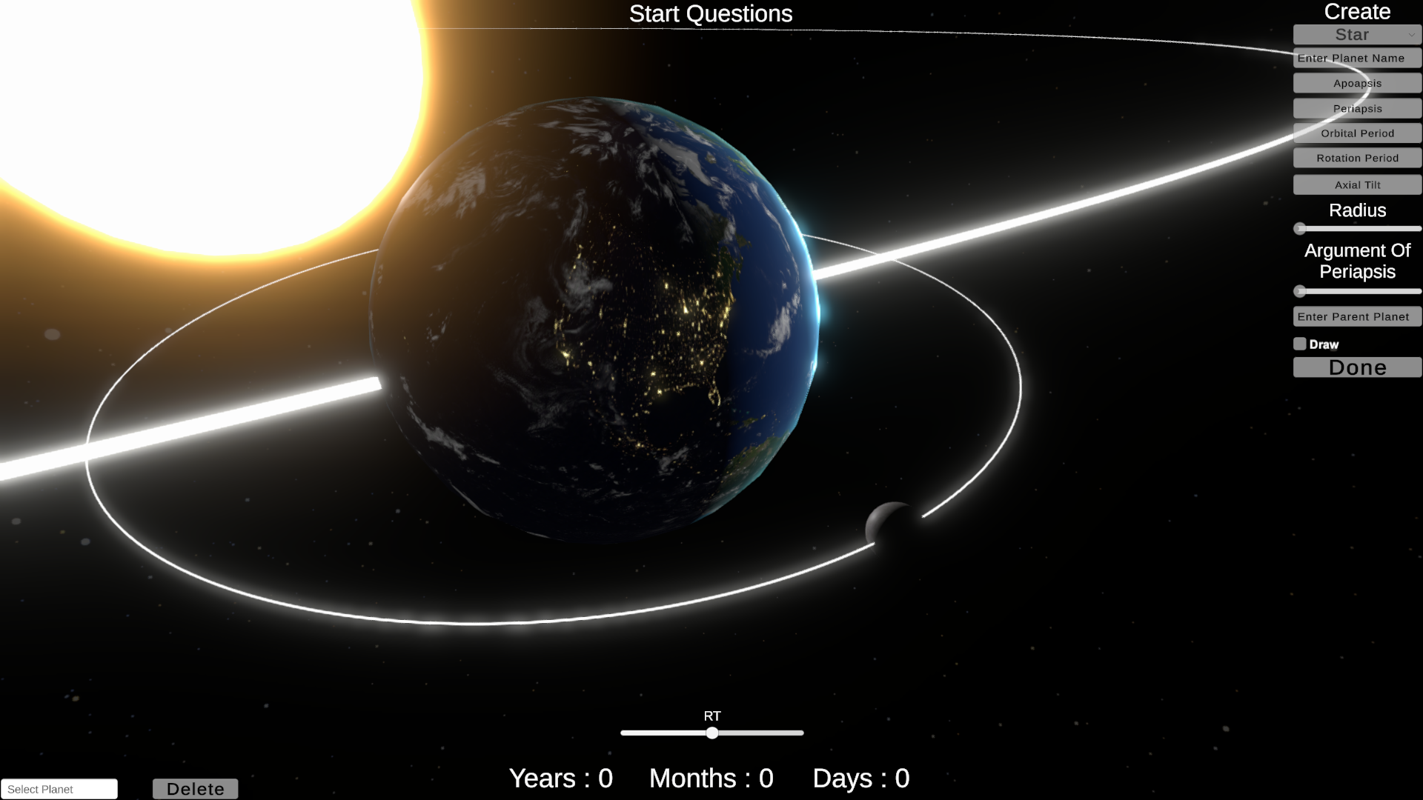
Lunar eclipse
Same thing as Solar Eclipse

Slide 7
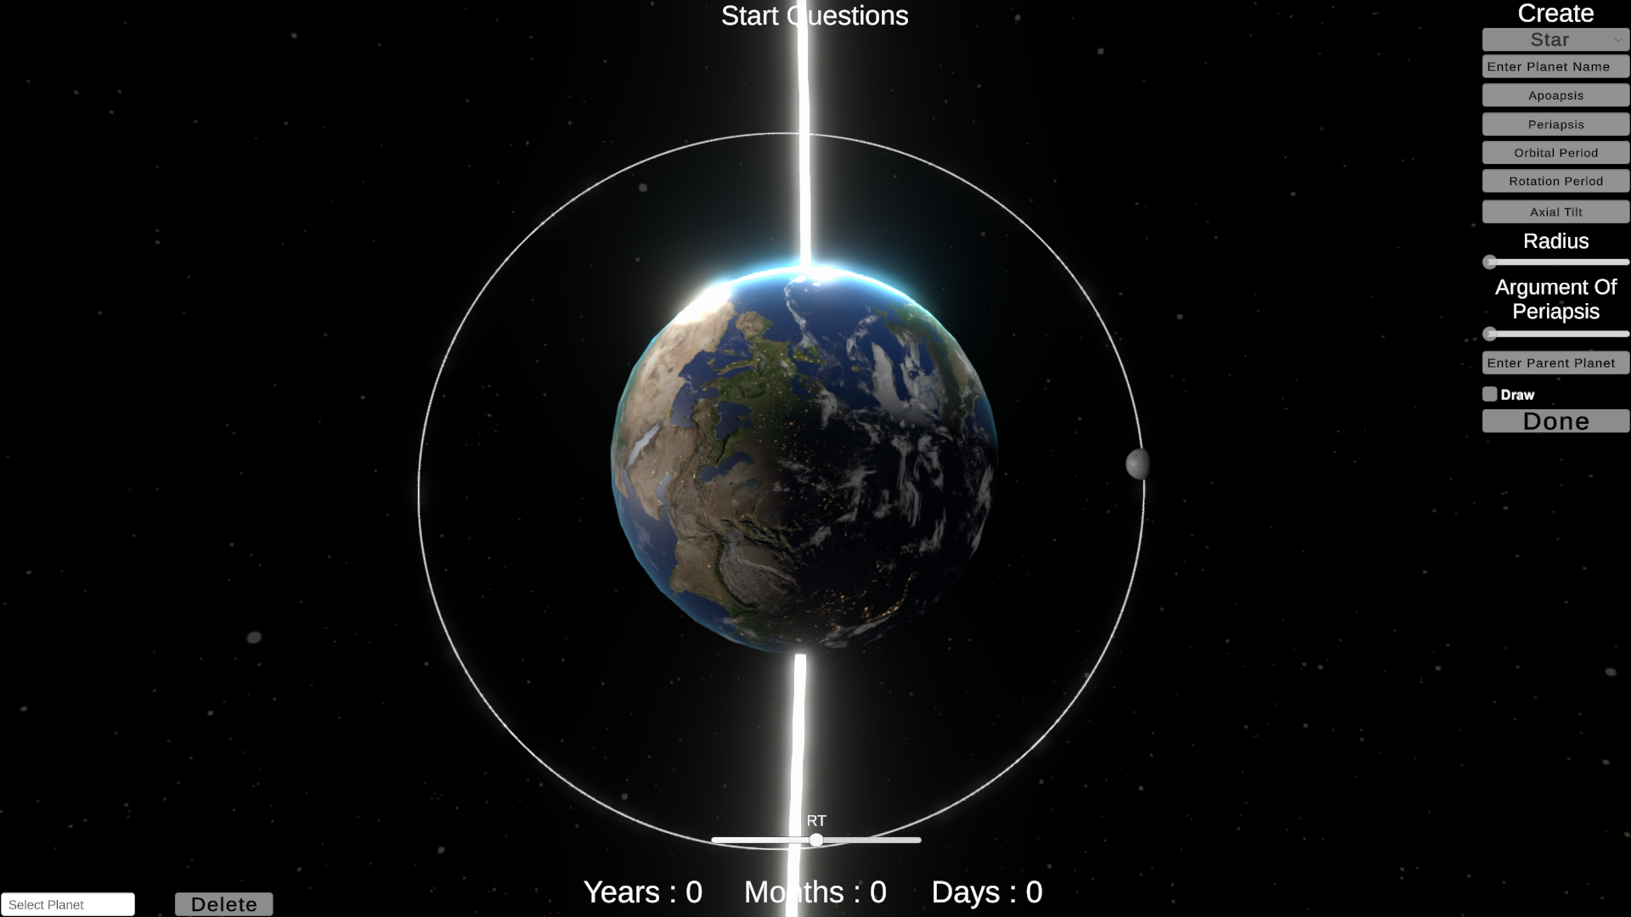
Travel in the SPACE
Enhance your experience by switching camera views.
Gain a fresh perspective on celestial events.
Explore the universe from different angles.

